Slide 1
Lending Club Case Study
Group Members:
Prity Bansod
Syed Mohabu Basha.S

Slide 2
Abstract
consumer finance company which specialises in lending various types of loans to urban customers. When the company receives a loan application, the company has to make a decision for loan approval based on the applicant’s profile.
Objective of the analysis is based on consumer past loan and find whether they eligible for new loan or not.

Slide 3
Data Processing
Consumer Data
Data Understanding (Review the data dictionary and understand the variables details)
Data Cleaning (Remove the null values columns based on percentage of values, remove irrelevant variables)
Analysis
Univariate (Analyse the each column of categorical and quantitative variable value and plotting them. )
Bivariate (Analyse the pairs of continuous variable like loan amount vs. distribution)
Endorse
Analyse the all column data, Using recommended variables identify these risky loan applicants ,which are strong indicators of default.

Slide 4
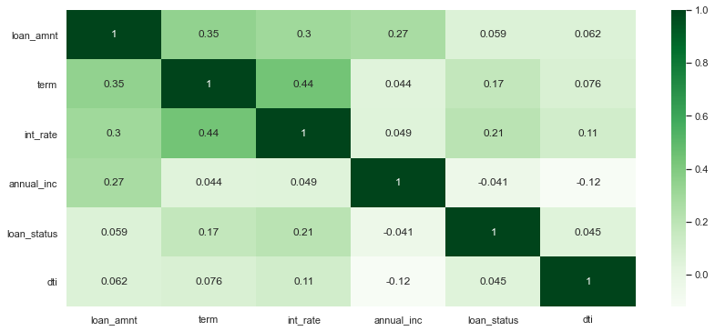
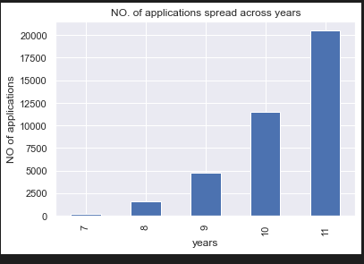
Analysis
Loan Across years
Funded Amount Behaviour
After cleaning the data we come to know that number of loan application increased with the years and funded amount behaviour

Slide 5
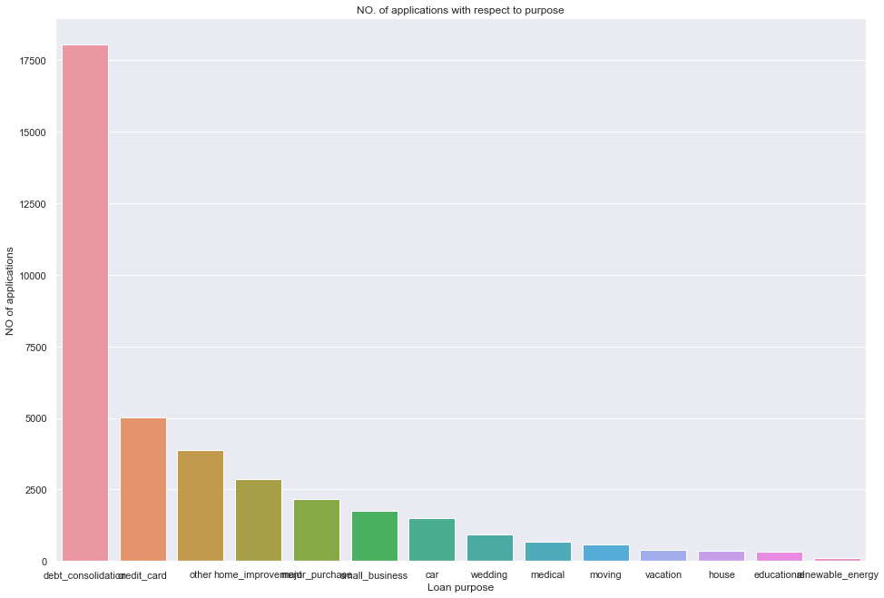
Analysis
There are five major purposes of Loan applications are - ‘debt_consolidation’ , ‘credit_card’ , ‘other’ , ‘home_improvement’ & ‘major_purchase’. ‘debt_consolidation’ is the highest loan purpose

Slide 6
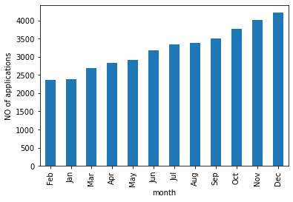
Analysis
Number of application received by month ,In December received more number of applications.

Slide 7
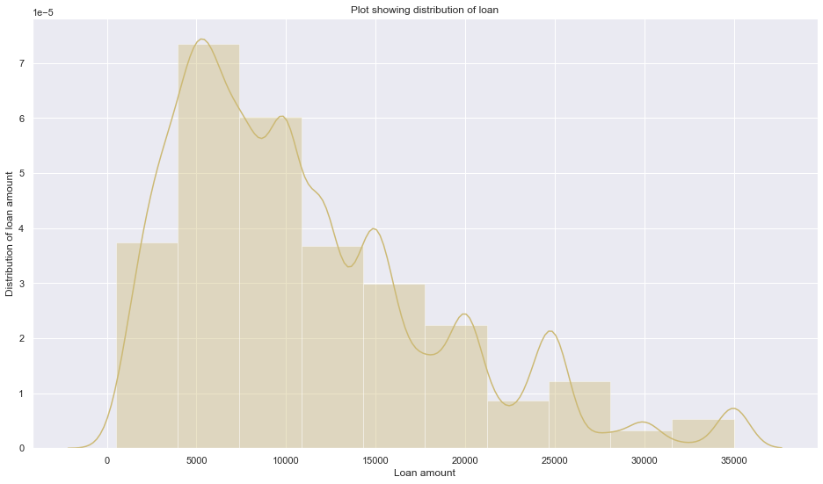
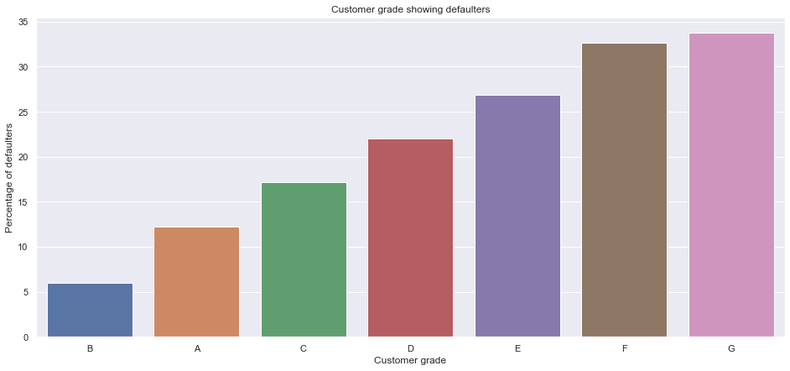
Analysis
Loan Range Amount
Defaulters
Observed that the maximum loan range amount is between 5000-10000.
Grade G group are have high percentage of defaulters.

Slide 8
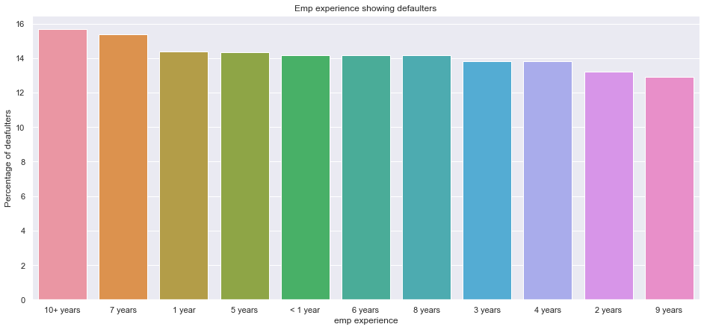
Analysis
The percentage of risk of Defaulters is maximum for customer experience - 10+ years & minimum for 9 year’s experience

Slide 9
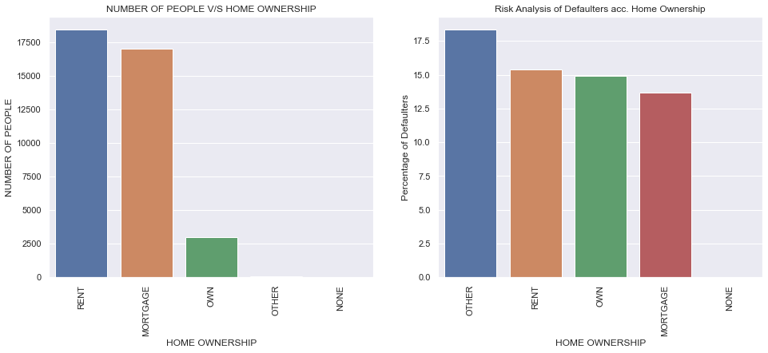
Analysis
The percentage of defaulter under home ownership is “Other” followed by “Rent” and “Own” and “Mortgage”

Slide 10
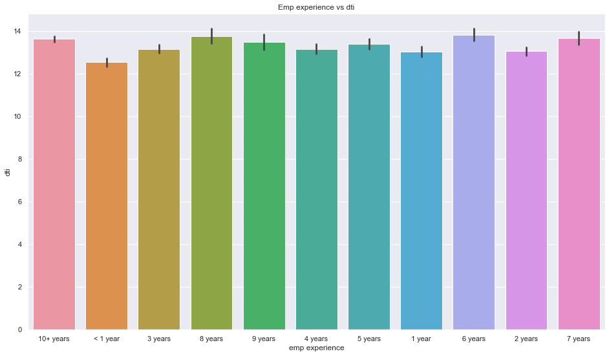
Analysis-Bivariate
By doing Bivariate analysis it has been observed that 10+ years of employee exp. Is having debt to income in maximum range apart from that rest year of employee exp. are more or less in same range.

Slide 11
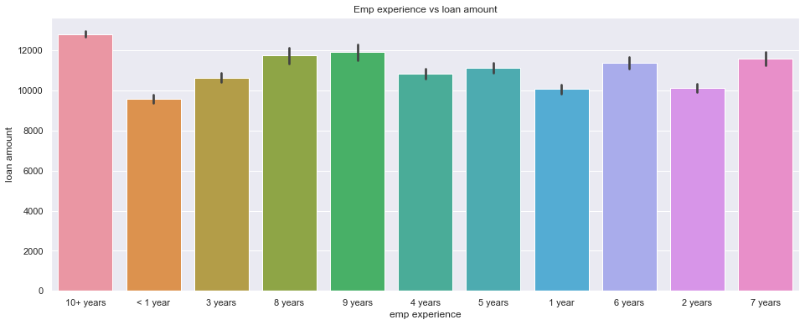
Analysis-Bivariate
By doing Bivariate analysis it has been observed that the employee exp. With 10+ years is taking more amount of loan and those who are less than 1 year is taken less amount of loan.

Slide 12
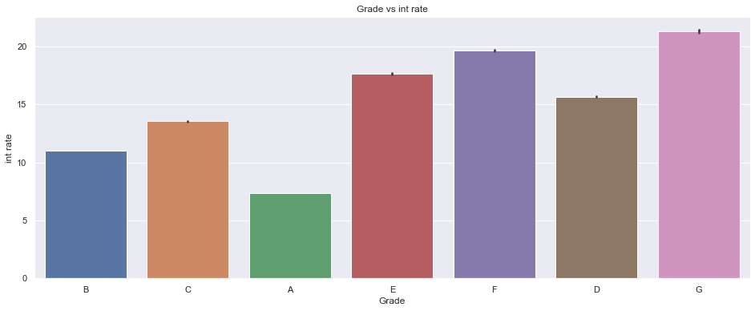
Analysis
From the above plot it has been visualize that based on grade interest rate is going higher – “A” is having minimum interest rate, whereas “B” is having higher interest rate.

Slide 13
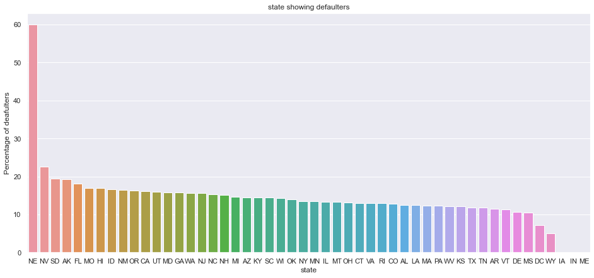
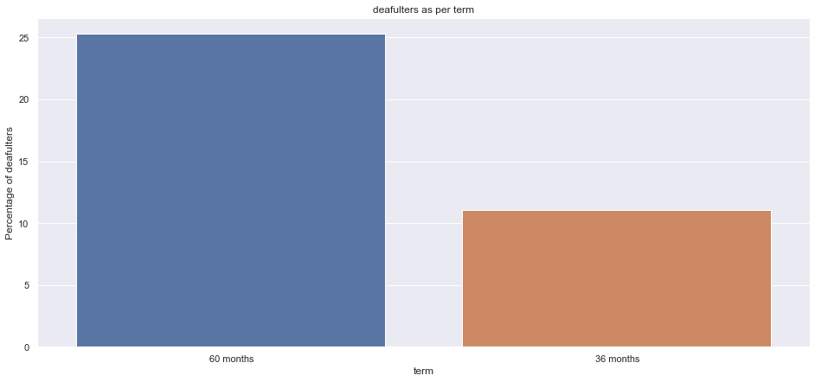
Analysis
Defaulters' in States
Defaulters loan term
The percentage of Defaulters is maximum from NE (address) which is 60%
The percentage of Defaulters is found in 60 months as compared to 36 months – Loan Term

Slide 14
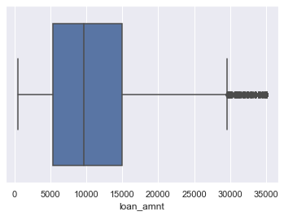
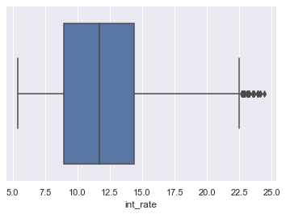
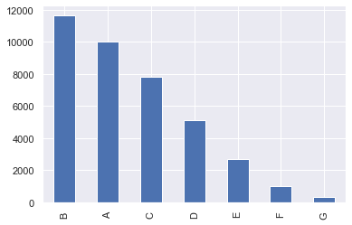
Analysis-Outlier
Very few people have taken loan more than 30000
Very few loan application have interest rate more than 22.5 percent
There are more number of borrowers having grade B

Slide 15
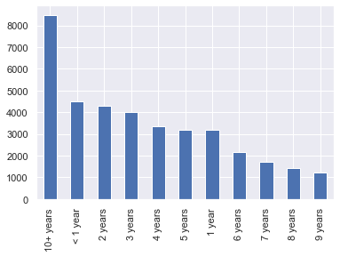
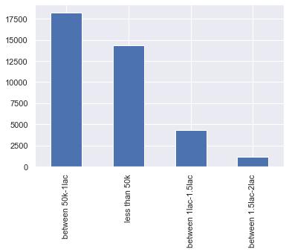
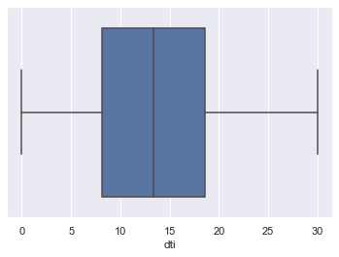
Analysis-Outlier
More number of borrowers are there whose experience is more than 10 years
There are more number of people whose annual income falls in between 50k and 1 lac

Slide 16
Conclusion
Upon Analysed the data funded amount inv as they are almost similar in behaviour to loan amount
Debt consolidation is the highest loan purpose.
Observed that the maximum loan range amount is between 5000-10000.
The percentage of risk of Defaulters is maximum for customer experience - 10+ years & minimum for 9 year’s experience
The percentage of defaulter under home ownership is “Other” followed by “Rent” and “Own” and “Mortgage”
Very few loan application have interest rate more than 22.5 percent .
The percentage of Defaulters is found in 60 months as compared to 36 months – Loan Term

